Slide 1
Auburn-USDA CS Clinic
Liaison Meeting (4/3/25)

Slide 2
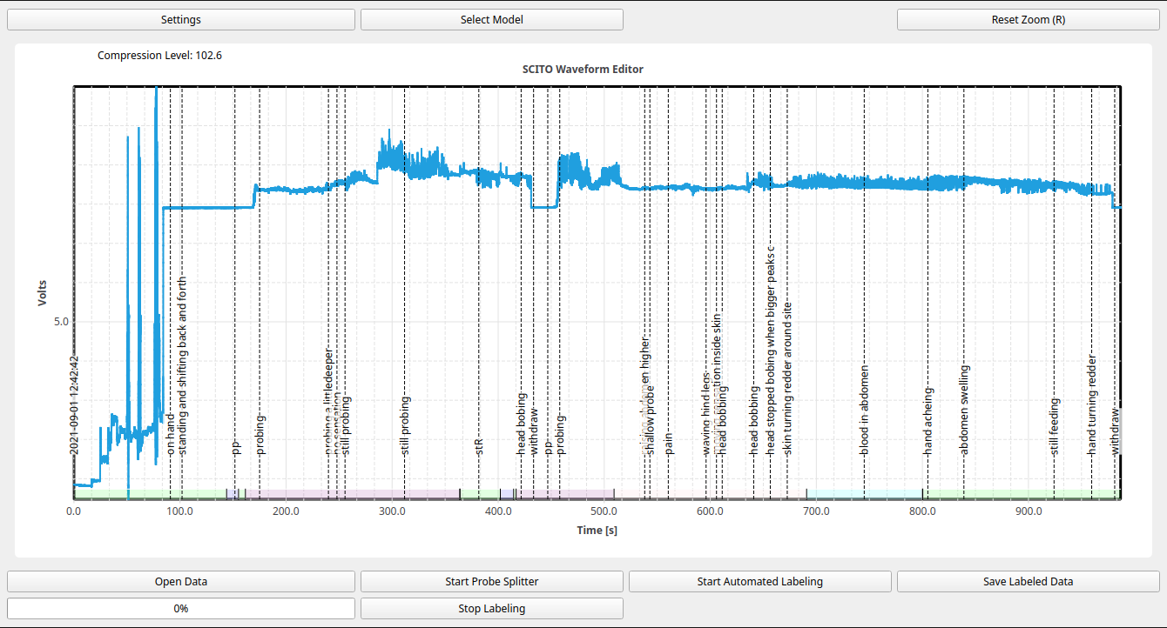
GUI: comment viewing

Slide 3
ML updates
Made a bunch (more!) UNet improvements (huge performance gains)
Made a bunch (more!) Transformer improvements (gains to be seen)
Writing both technical and non-technical reports for Dr. Cooper
Frankendata issues
Current model ranking (hyperparameter search ongoing).
Best Model: UNet
Worst Model: Random Forests

Slide 4
Steps before feature freeze

